Slide 1
O3 Access Control Solution

Slide 2
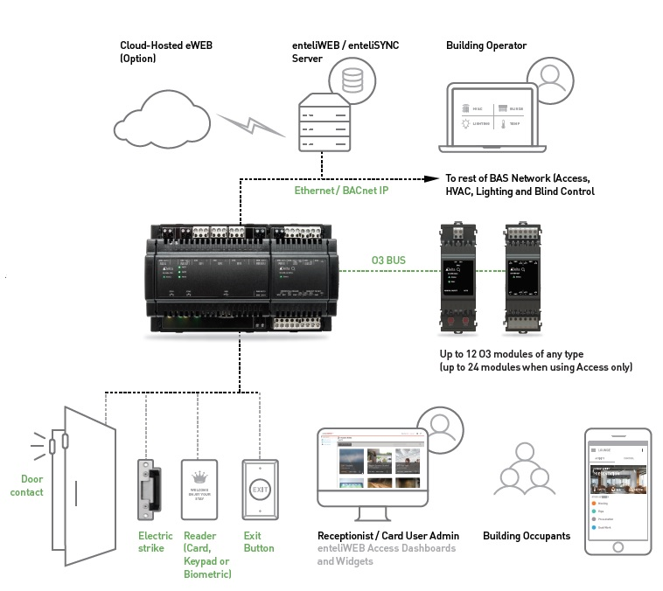

Unique Selling Points
Software:
Single-seat management software - enteliWEB
GDPR compliant synchronization engine – enteliSYNC
Virtual Enrollment Reader
Intuitive dashboards for user enrollment
Customizable extended access user information
Role-based permissions for different users
Visualizations via widgets and graphics that reports live data
Customizable access activity report
Controller:
Compact size, takes less space
Integrates with other O3 modules for all BAS application
Multi-format Wiegand reader support from a single input (up to 200 bits)
Standard BACnet Access objects
24V and 12V output power option for door peripherals
Additional universal input/output point
Powered through PoE or standard power supply

Slide 3
Delta Strength
Integrated System with one front end and infrastructure
HVAC, Lighting, Access, Surveillance, EV Chargers, VFDs, Energy, Special Interfaces, etc
Flexible integrated system
GCL+ offers endless possibilities for customization/sequencing
Lower install costs
Access architecture and hardware designed for lower install cost
Leverage infrastructures both infrastructure/network and single enteliWEB
Lower operational costs
Access dashboard focused on management of system puts the daily operation in hands of non-technical staff

Slide 4
O3 Access Dashboards Licensing Model
Based on number of doors
Access IO wont be counted towards eWEB licensing
Subscription 7.5% annually – just like eWEB
Grace period of 30 days if door limit exceeded – dashboard will be disabled
After 30 days grace period if door limit is within limit – dashboard continues to work
eWEB/eSYNC upgrade not allowed
Limited support
DOORS (ACD) | NOTES
< = 5 | Preview / Tiny Site
< = 50 | Light Commercial / Strip Mall (Single Building)
< = 250 | Medium Commercial
< = 500 | Hospital / Large Condo
< = 1000 | Multi-Building Site
Unlimited | University Campus / Military Sites
Notes:
List price
eSYNC free
LPM model
eWEB license is required. Smallest would be fine

Slide 5
What is next coming?
More Wiegand card formats - feature gap
OSDP – Europe and NA recently
Multi-Factor Authentication – feature gap
100K access user database – covers 90% of the use cases
New Dashboards and Widgets – workflow and visualization, recurring revenue
Door Templates – reduce engineering time
Vivotek People Counting Camera Integration – room optimization

Slide 6
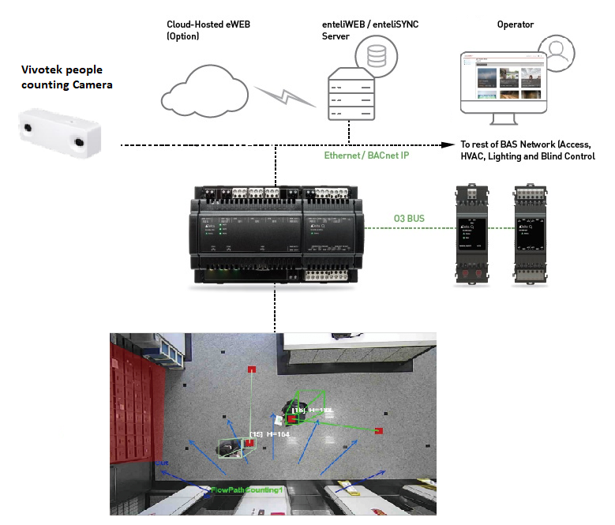
People Counting Solution
Integrate with O3
User scenarios:
Field detection and room optimization
Dwell time detection
Security solution to detect and report tailgating
Verticals:
Commercial
Education
Retail
Vivotek Channel:
Vivotek Smart Access Control…Powered by Delta Controls

Slide 7
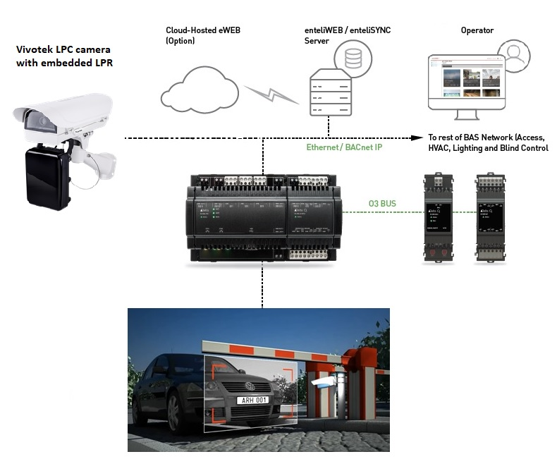
LPC Solution (Future)
Vivotek License Plate Capture cameras with embedded LPR engine
Integrate with O3
Map license plate into BACnet object
User scenarios:
Parking solution

Slide 8
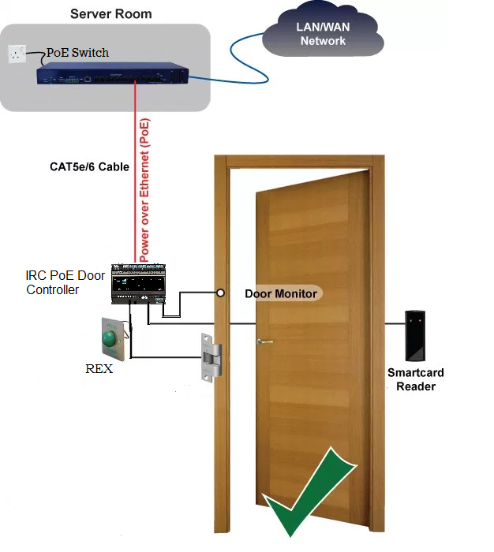
2 Door PoE Controller (Future)
Current PoE module supports 1 door at 21W
New 2 doors PoE controller
PoE+ (802.3bt) at 60W
Locks, RTE, readers
Users stored locally
One run of CAT5/6 cable
Backup power at switch

Slide 9
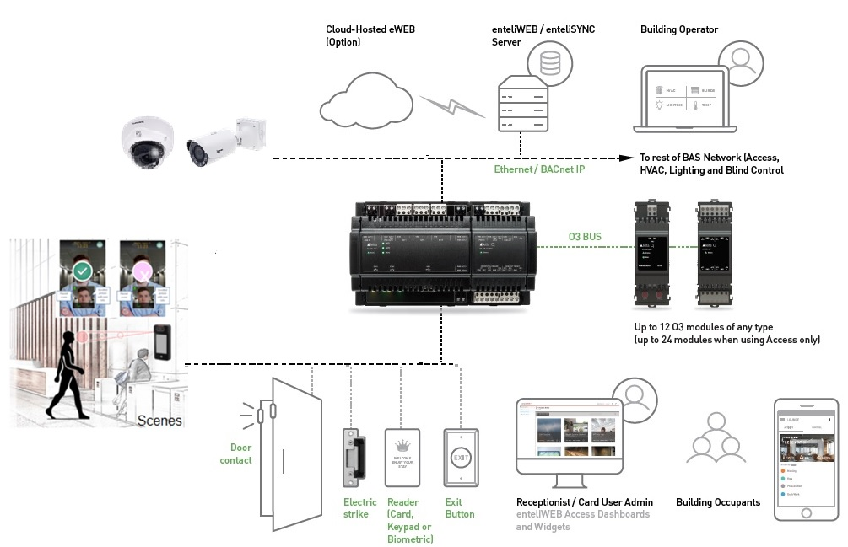
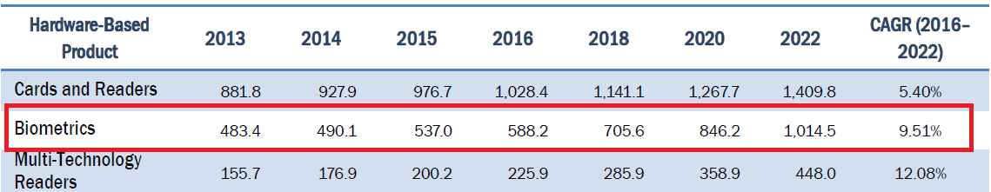
Facial Recognition (Future)
Biometrics are increasingly being adopted to increase security level of access control.
Expected to reach $1,014 million by 2022 globally.
Facial Recognition is expected to grow at CAGR of 12.27%, highest among other biometric technologies.

Slide 10
Thank you!
Q&A

