Slide 1
O3 System Sales Presentation

Slide 2
O3 System - Benefits

Slide 3

Tech, industry & markets are converging.
CONVERGENCE
Market Convergence

Slide 4






VISION
Integrated Room Control increases a building’s value…
Higher Productivity
Increased Value
EarthrightTM Energy Efficiency
Reduced Operating Costs
Optimized Occupant Experience
VISION OF INTEGRATED ROOM CONTROL

Slide 5

Convergence versus Integration
A single edge controller brings all disciplines together and so a room behaves as a room – not a collection of unrelated data points passed to an upper level.
Integrate means the lighting controller, the HVAC controller and the access controller are tied together at some central point in the building.
Converge all controls in a single controller that knows what a “room” is.

Slide 6
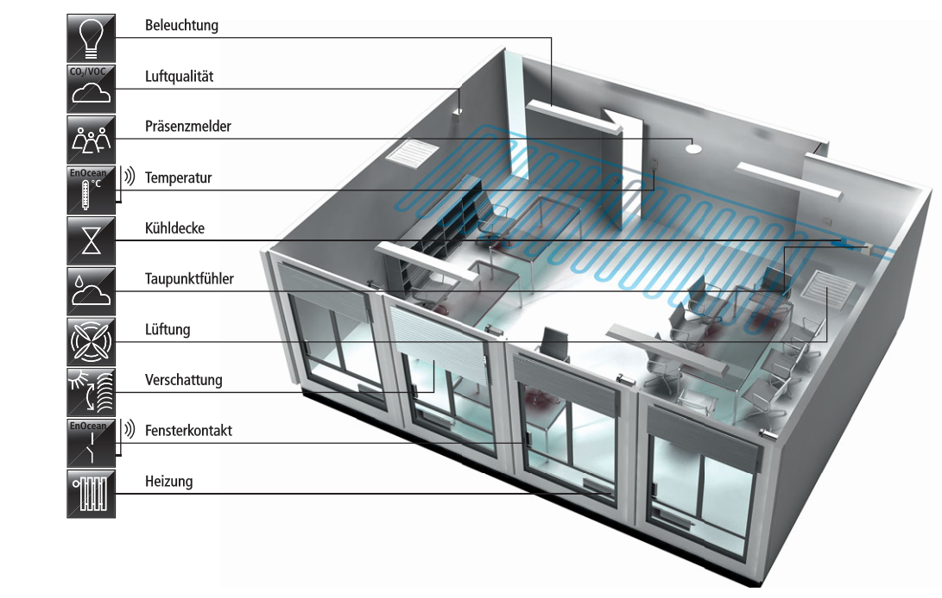





Lighting
Air Quality
Occupancy
?
Temperature
Chilled Beam
Humidity
I/O
Ventilation
Shades
Window Contacts
Heating
I/O

Slide 7





Bringing the protocols together in the room
P E

Slide 8
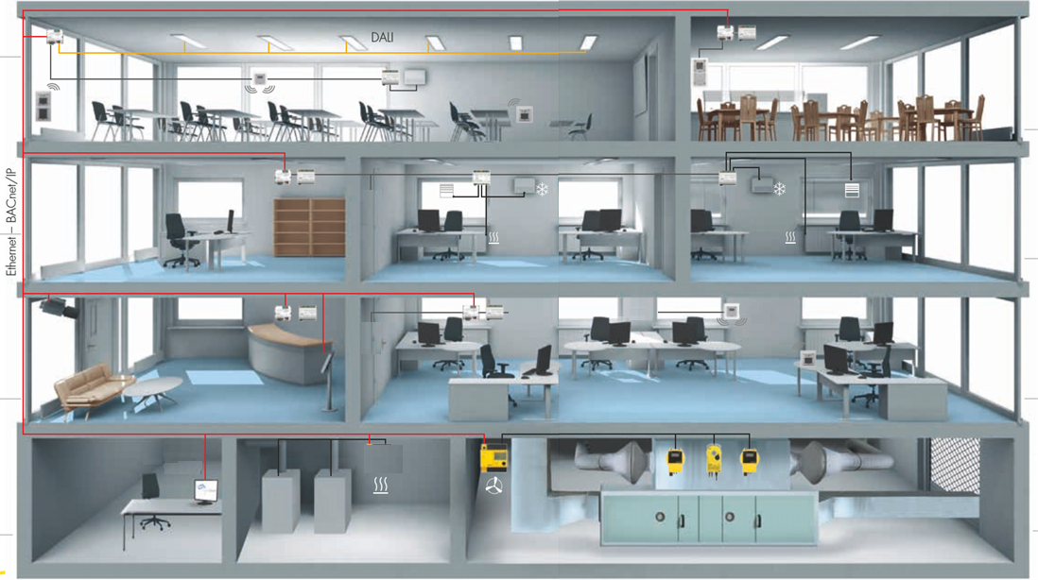

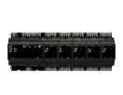



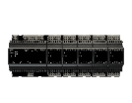
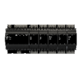
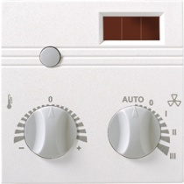
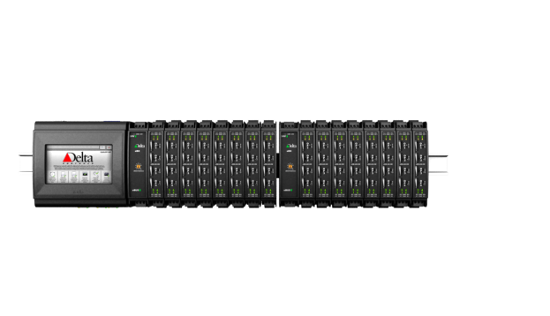

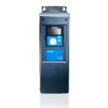
enteliWEB

Slide 9

MEETING ROOM
Activity Meeting Mode
Set Point 21°C
CO₂ Level 1300ppm
Top Lighting 60%
Shades Auto
Music Level 40 dB
Sound Level 65dB
# People 9
TV Mode 1

Slide 10
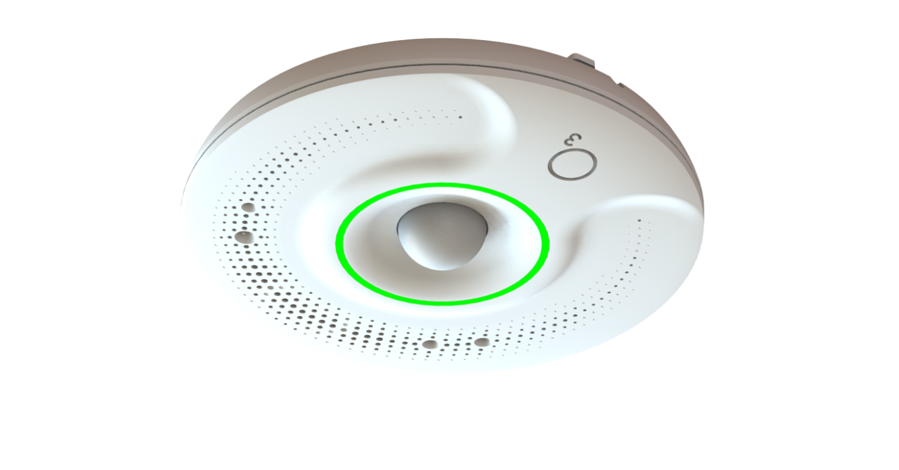


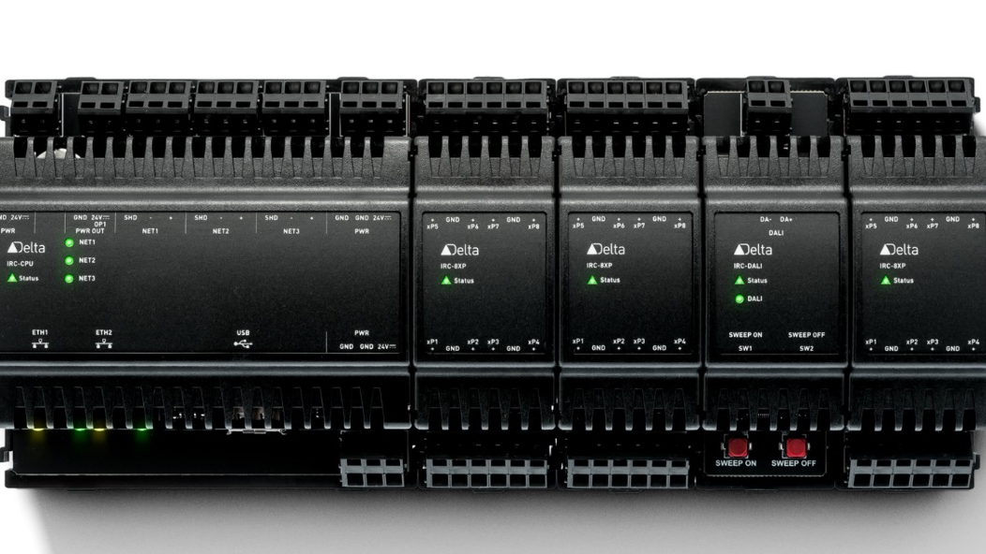

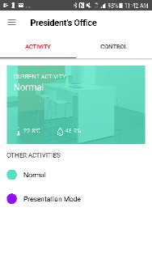
O3 System
enteliWEB
O3-DIN Flexible I/O
O3-HUB
Rich Sensors
Wireless
O3 Room Control App
enteliWEB
Notes:
When we talk about the O3 it isn’t just the Hub, and it’s not just the DIN modules – it’s the overall system and that includes the App, the eWEB services API and all the features we’ll talk about here.

Slide 11
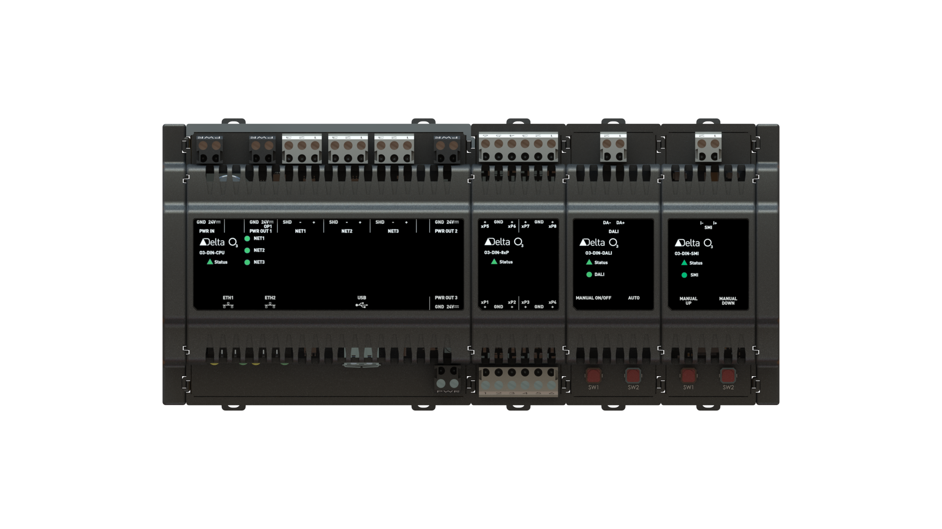
O3 System - Components
Controllers and Modules

Slide 12
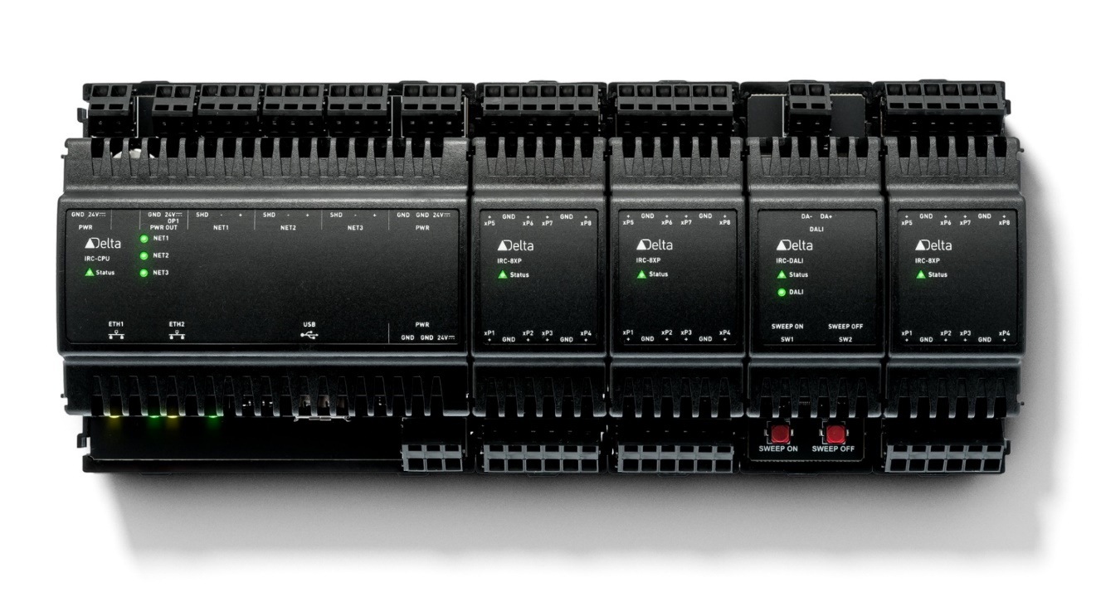
Integrated Room Control
FLEXIBLE. MODULAR.
CPU Protocol integration
HVAC (Heating, Ventilation, Cooling)
Lighting Control (DALI, I/O)
Shades Control (I/O, SMI)
Access control
Integrates everything in a room with protocol modules and a sensor hub
Improved Occupant Experience with visual and audio feedback
Local Analytics

Slide 13
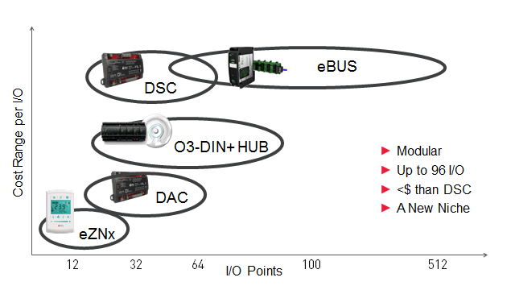
Product Position
DIN-SRC
Up to 32 I/O
Notes:
When promoting to partners, …
DSC and eBUS have a cost per I/O
eBUS has its own features that differentiate – dense I/O, HAO switches, Hot swapping
O3-DIN with 8xP modules has a lower cost per I/O point than the DSC and eBUS.
It doesn’t compete directly with DAC’s. They are still the lowest cost

Slide 14
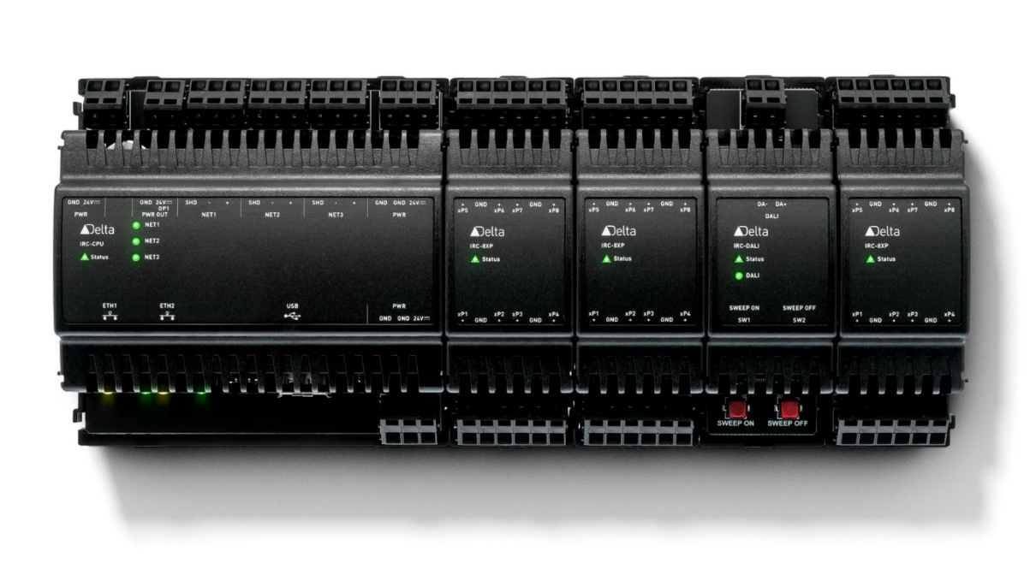

2 x RS 485
Space-saving design
for DIN rail mount in
Electrical sub-panels
Shades
2 x RJ45
Ethernet
BACnet/IP
2 x
USB
1 x RS485
BACnet
MS/TP
8 x UI/UO
AI, BI, AO,
LO, BO, MI

Slide 15


Integration Engine: CPU
Specification
600 MHz
4GB eMMC Flash Storage (2 GHz)
256 MB DDR3L RAM
Ultracap Backup for RTC and CPU Data
Power
24 VDC Input
3 x 24 VDC Output to supply
Thermostats
3rd Party Devices
Power Injectors
Hubs
Etc.

Slide 16
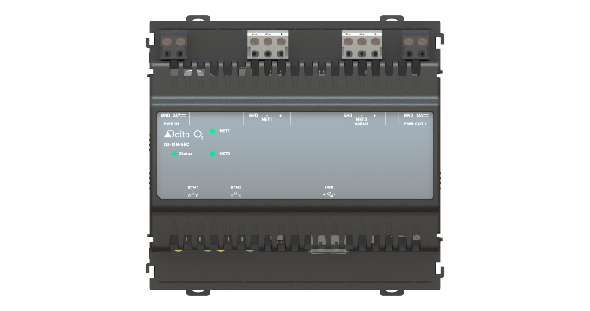
Single Room Integration Engine: SRC
Specification
600 MHz
4GB eMMC Flash Storage (2 GHz)
256 MB DDR3L RAM
Ultracap Backup for RTC and CPU Data
Power
24 VDC Input
1 x 24 VDC Output to supply
Thermostats
3rd Party Devices
Hubs
Etc.

Slide 17
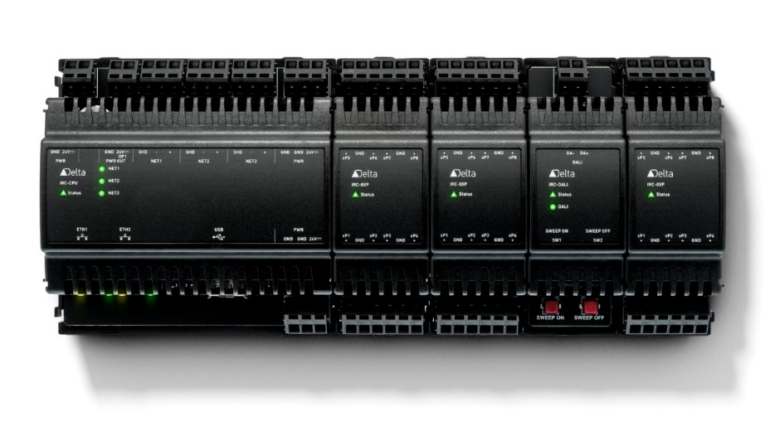
Integration Engine CPU
Communications
2 x Ethernet (10/100MB)
BACnet IP, BACnet over Ethernet
Daisy Chain capable
3 RS-485
NET1 – MS/TP, LINKnet, Modbus, etc.
NET2 – MS/TP, LINKnet, Modbus, etc.
NET3 – O3BUS, MS/TP, LINKnet, Gateway
2 x USB (Host)
Storage, Upgrades, Wireless, Charging
Status LED
Green – Normal
Yellow – No Fieldbus Power
Red – Fault, Error
NET Port LED
Ethernet LED

Slide 18
Single Room Integration Engine SRC
Communications
2 x Ethernet (10/100MB)
BACnet IP, BACnet over Ethernet
Daisy Chain capable
1 RS-485
NET1 – MS/TP, LINKnet, Modbus, etc.
1 O3BUS (CAN-based)
NET3 – Hubs & Power Injectors
2 x USB (Host)
Storage, Upgrades, Wireless, Charging
Status LED
Green – Normal
Yellow – No Fieldbus Power
Red – Fault, Error
NET Port LED
Ethernet LED

Slide 19
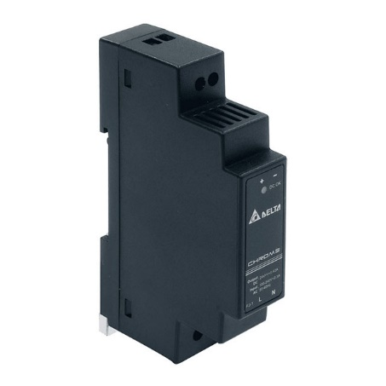
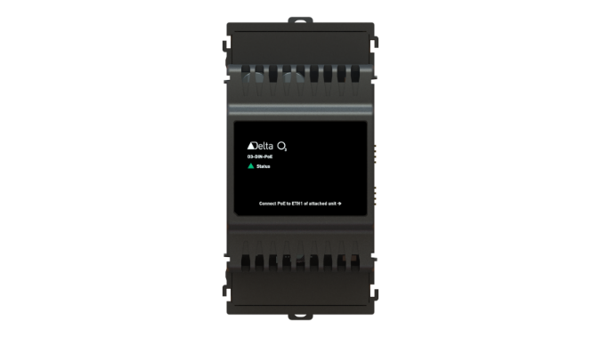
Power Supply
24 VDC in
24 VDC out
AND PoE Ready
New 2019 Q1

Slide 20
Universal I/O: O3-DIN-8xP
Software configurable: AI, BI, MI, AO, BO, LO
No Jumpers!
Any I/O mix of 8 inputs and outputs

Slide 21
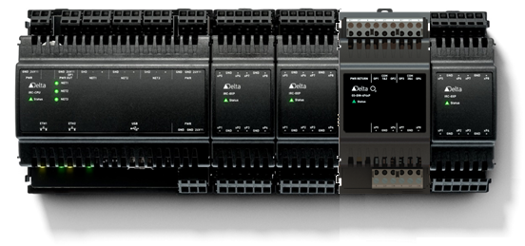
Binary Outputs O3-DIN-4F4xP
Characteristics
4 FET outputs
500mA output current
Staus LED
AC or DC voltage switching
4 universal I/O pins included
Objects
BO
New 2019 Q1

Slide 22
DALI
Characteristics
64 Ballasts
64 input Devices
Switches
Occupancy Sensors
Staus LED
DALI 2-wire Network
Power supply in the two wires
100mA DALI power supply built-in
Objects
LC – Lighting Control Object
Light Group control
Motion Sensor inputs
LO – Lighting Output Object
Define output control (Dimming, Fading, Blink Warn, etc.)

Slide 23
SMI
Characteristics
16 Shades Motors
16 Groups
Staus LED
SMI LoVo & Line Voltage
Power supply in the two wires
Up & Down override buttons for commmissioning
30mA power supply built-in

Slide 24

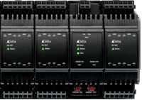
Power Injector
New 2019 Q1
Characteristics
8 address positions by rotary switch
1 Power Supply input
Staus LED & O3BUS LED
1 O3BUS 3 pin connection
2 Power Supply outputs
Built-in O3BUS termination
Benefits
Connect more modules to controller
Mount I/O remote from the controller

Slide 25
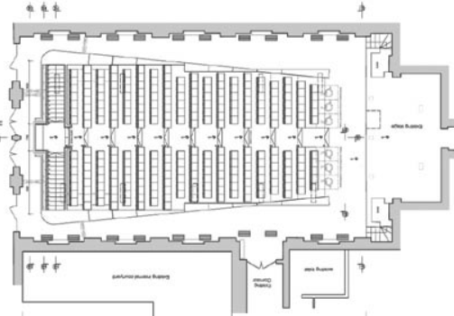
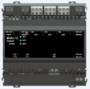
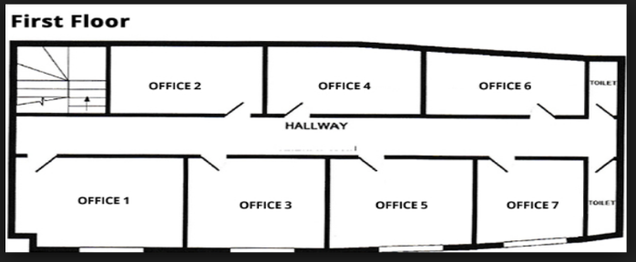
Room Applications
Larger Room
HVAC
Light, Blinds
Multiple Rooms
HVAC
Light, Blinds
CPU
PWR INJ

Slide 26
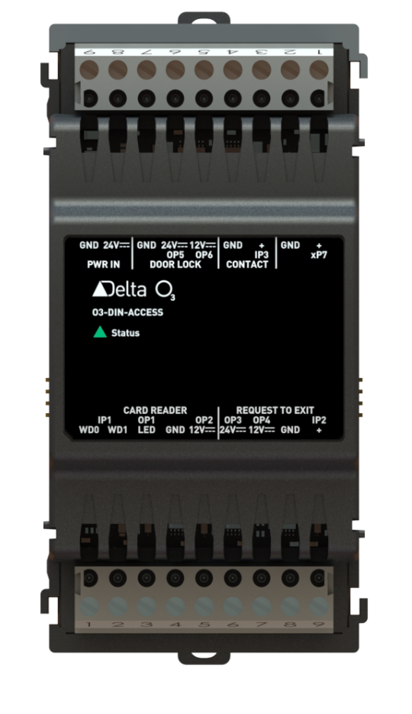
O3-DIN-ACCESS Module
Power in
Door
contact
Door
lock
Universal
point
IO interface for a typical single door / credential reader
IO specific to access control application
Wiegand input with LED output
26 bit
37 bit
37 bit facility
Simple 32
Supervised input circuits - Door Contact and RTE
Door lock outputs
12V/24V power output
Additional Universal IO - Software configurable
Supports multi-format reader from one input interface
New 2019 Q1
Card reader
REX

Slide 27

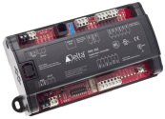
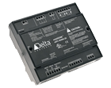


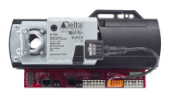


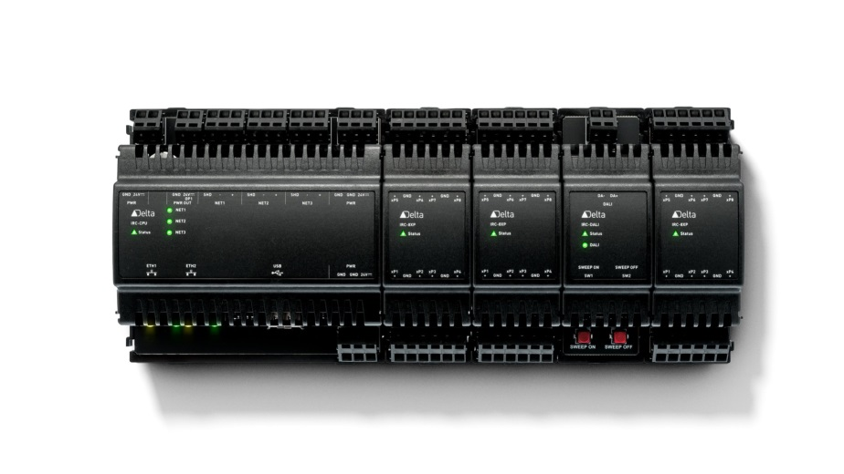
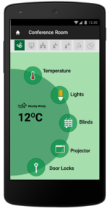
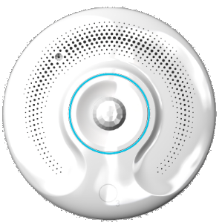
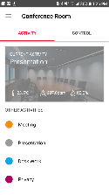







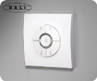
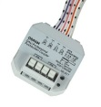



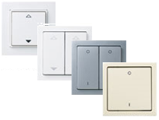
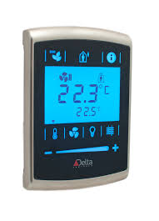

Connectivity
Bluetooth Location beacon
Audio signature Occupancy
MS/TP
Temperature, Occupancy, Light, Humidity
AV Equipment
Occupant Comfort, Energy Saving
Ethernet
LINKnet
Universal I/O
Inputs: 10k, 0-5VDC, 0-10VDC, 4-20mA
Outputs: 0 to 5 V output, 0-10VDC (Source 20mA, Sink 10mA)

Slide 28
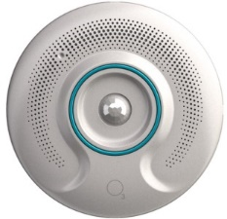
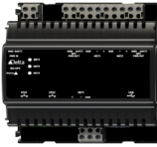
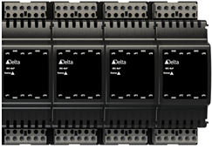
System Wiring O3-DIN-CPU
Up to:
8 Remote Hubs
4 modules directly attached to CPU
4 modules to each Power Injector unit
12 modules per CPU
24 if they are Access Door Modules

Slide 29


System Wiring O3-DIN-CPU
Up to:
8 Power Injectors
4 modules directly attached to CPU
4 modules to each Power Injector unit
12 modules per CPU
24 if they are Access Door Modules
. . .
e.g. Up to 6 O3-DIN-PWRINJ if 2 hubs connected

Slide 30
Low Cost: Single Room Controller
Low Cost little brother of O3-DIN-CPU
1 serial port
2 Hubs maximum
Same power
PoE Ready

Slide 31
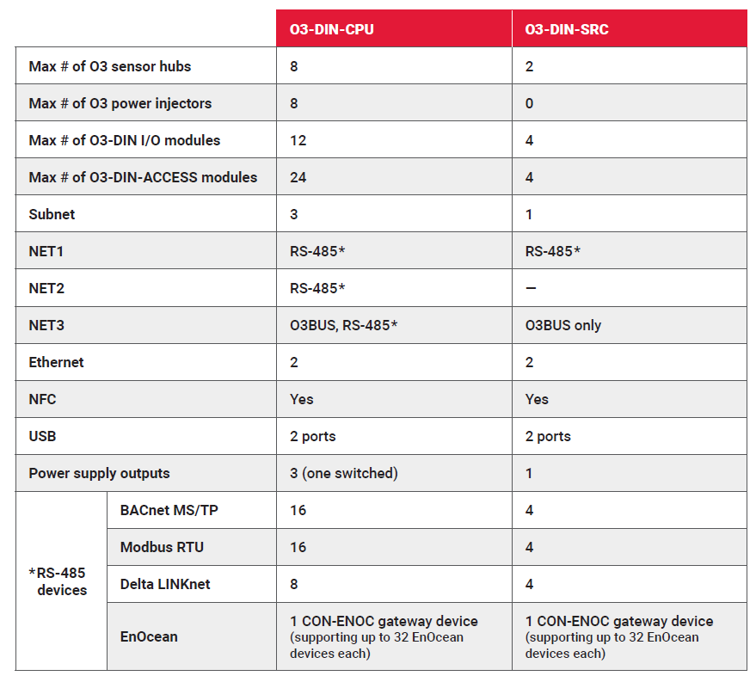
Features and CPU SRC comparison
Same hardware,
Same database,
Smaller architecture
Lower Cost per room

Slide 32

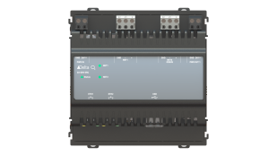

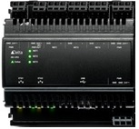




SRC Versus CPU Controller
CPU System Layout
SRC System Layout
Modbus
or
LINKnet
or
MS/TP
Modbus
Or
LINKnet
Or
MS/TP
Analog I/O
Binary I/O
DALI
Access
#1
Light, Temperature,
Sound,
Occupancy
#1
#2
#3
#1
Light, Temperature,
Sound,
Occupancy
#1
#2
#3
#2
. . .
#32
#2
. . .
#32
#6
PWRINJ
PWRINJ

Slide 33
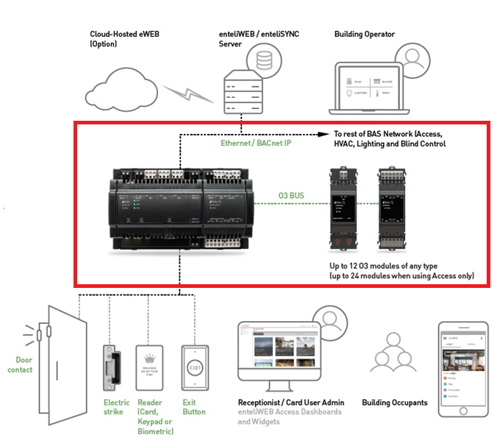

O3 Access System
Controllers
O3-DIN-CPU and/or O3-DIN-SRC
O3-DIN-ACCESS
O3-DIN-PWRINJ

Slide 34
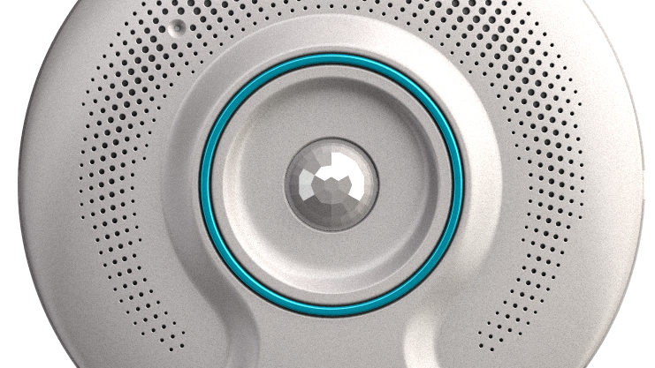
O3 System - Components
Sensor Hub

Slide 35
Features
Temperature
Humidity
Light Intensity
Light Color
Occupancy
Microphones
EnOcean radio Tx Rx
Bluetooth LE radio Tx
Infrared remote Tx
8 sensors
3 wireless technologies
Speaker
12 full color LEDs in ring
Notes:
I want to impress on people that this is a fully featured product with so many elements built-in.
The opportunities are endless
We’ll go into detail on a few of these sensors to show you just how much Delta innovates

Slide 36
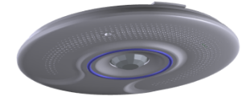

Sensor Fusion: Smart Temperature
Compensates for ceiling mount
Calibrate where you are in the room
IR temperature senses FAST!
Enables optimum start for occupancy
Digital Temperature
Multi-sensor composite
Infrared Temperature
Notes:
A competing product has temperature sensing in the ceiling. They don’t recommend driving heating control from that sensor.
Delta went a step further and projects the temperature into the space with new technologies
Calibrate to the desired temperature, at the desired location. The system now controls to that location with accuracy around that temperature
Compared to a stat on the wall that senses the temperature in one location in the room, the Sensor Hub senses in the middle of the room, or at least where the occupant is more likely to be, and senses a wide area of the room rather than a single point.

Slide 37
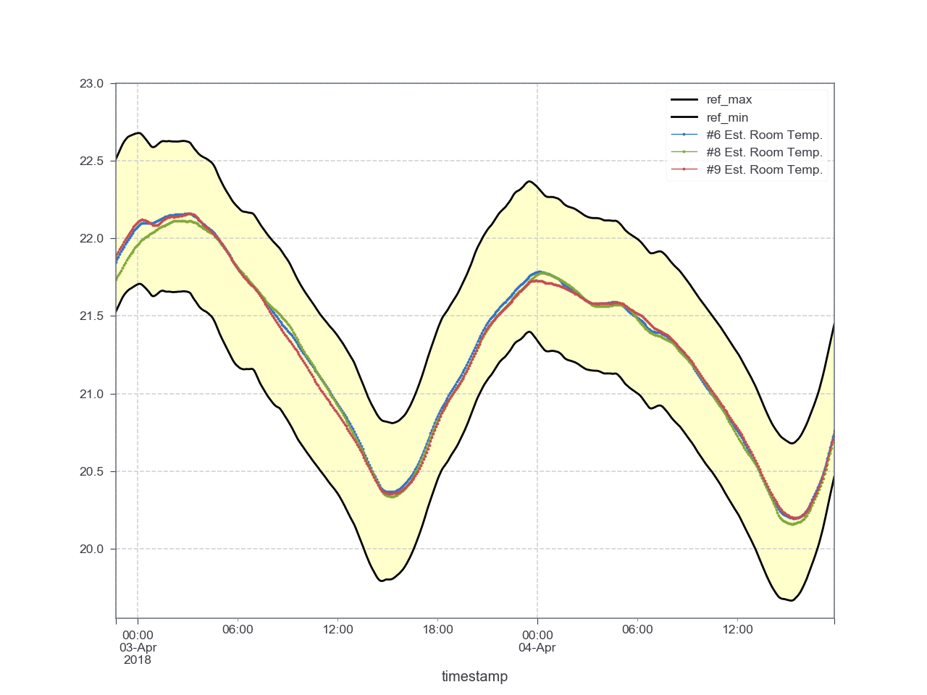
Tracks temperature accurately
Notes:
In our test facility with 5 precision temperature sensors in the room, you see the yellow band is the range of those reference temperatures.
Once calibrated, the three hubs shown track right down the middle of the room’s temperature over a 24 hour period
The hub is +/-0.5degrees

Slide 38
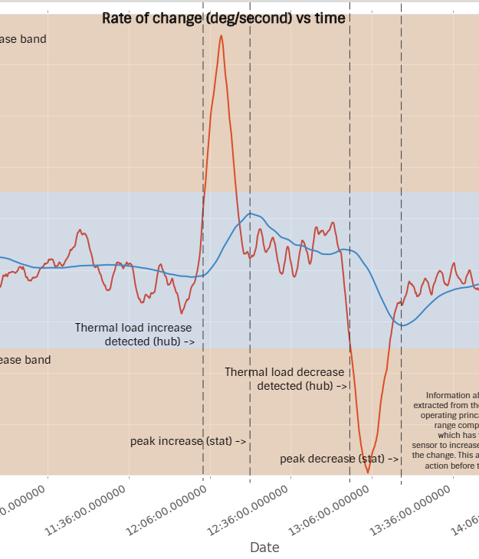
Sensor Fusion: Smart Temperature
15 minutes faster than a wall-stat
Save energy on occupancy, and vacancy cycles
Notes:
I said that IR temperature sensing is fast. 15 minutes faster than the stat on the wall.
So, the Optimum Start concept that partners already use for beginning of the day to conserve energy is now available for the moment a room becomes occupied
More efficient and timely comfort while saving energy

Slide 39





Sensor Fusion Occupancy
Microphones
Microphones
PIR Occupancy
Sensor Fusion Occupancy
IR Temperature Spike
Audio Signature
Infrared Temp.
Occupancy
Notes:
Note: PIR triggers occupancy, Audio, infrared both latch it.
Fewer false vacancies, and quick off time after real vacancy
Sensitivities can be adjusted to accommodate quieter spaces, or louder spaces
Up to 10’ height for mounting. Up to 22’ diameter

Slide 40
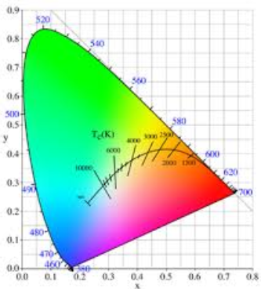

Features: Light Sensor
Senses brightness for daylight harvesting applications
Senses Light Color RGB or Temperature in Degrees Kelvin
Color for Circadian Rhythm control and sensing
Color for animal care in university labs
Notes:
The light sensor is built in there too. Light intensity in Lux or foot-candles can be read by using the correct AIC object.
Color is a big coming thing in lighting, so we have that in there as well. Sense in RGB values or Color Temperature
Fish like different blue tones to the light so universities are approaching us with requests for color control and sensing that color.
Control of lighting color in elderly care and other medical facilities is reported to have good results for productivity, and wellness. The light sensor aids in bidding on these types of jobs.

Slide 41

CLOSER TO OCCUPANT
TAMPER AVOIDANCE
LOCATION
INDIRECT SUNLIGHT
OPEN OFFICE
CUBICLES
RADIO ANTENNA
OCCUPANCY
WALL ACNE
EASY TO MOVE WALLS / EQUIPMENT
T-BAR vs WALL INSTALLATION
Notes:
Like they say in real-estate it’s all about Location, Location, Location
Look at all these…
Sensing in the right place, not at the doorway,
Senses light from the ceiling out of the direct sun from windows
Radio antennas are in the center of the room for least interference, I can go on
Wiring in the ceiling is way easier than down a wall.
What if the wall needs to move, then what?
What if there is no wall. Just cubicles the Hub is ideal
Vandalism is far less a concern compared to switches or stats on the wall.

Slide 42
O3 System - Components
Room Control App

Slide 43
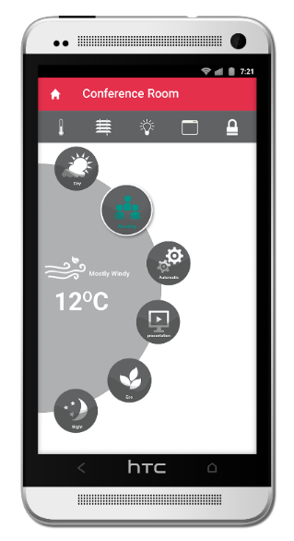
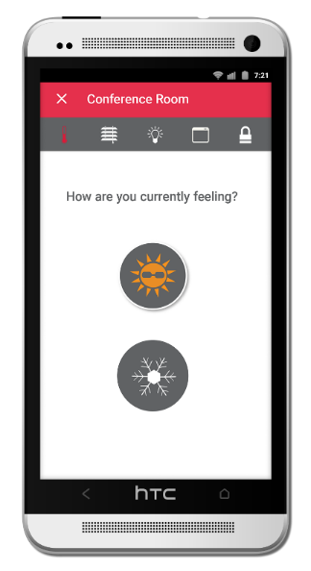









Slide 44






Room Control App
Room Location Hubs know when you’re nearby
Easy
Experience Activity Control Hub feedback – LED ring, sound
Notes:
Just a quick note on the Room Control App,
It senses which room you’re in and gives you control over elements in that room.
Highly integrated, highly occupant centric, highly convenient.

Slide 45
O3 System - Components
enteliWEB

Slide 46



Slide 47












Delta provides a full suite of Building Automation System components
Use Web Services, or use the ODBC connector
Real-Time-Analytics
Real-Time Applications
http/https
Clients (Web Browsers)
Web Services (REST)
IIS Web Server
PHTML
(Templates)
PHP
(Core Logic)
Local MySQL Database
Trendlog
Events, Alarm^s
ODBC
Historian Database
Delta PHP Extension
eWEB Connect Service
BIRT Runner
(Reports)
BACnet Server 4.0
BACnet Site A
BACnet Site B
BACnet Site C
BACnet Site D

