Slide 1

Delta V4 Access Control
Overview

Slide 2
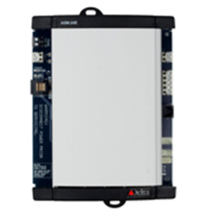
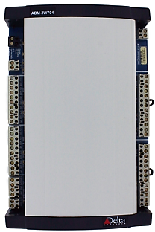
Delta Access Control Solution V3 Access
CPU provides local authentication & authorization
Controls up to twelve door modules via LINKnet (RS-485)
ASM
2 single direction doors or 1 bi-directional door
Up to twelve door modules may be connected to an ASM/eBMGR via LINKnet (RS-485)
built-in battery charging circuit
ADM-2W704
2

Slide 3



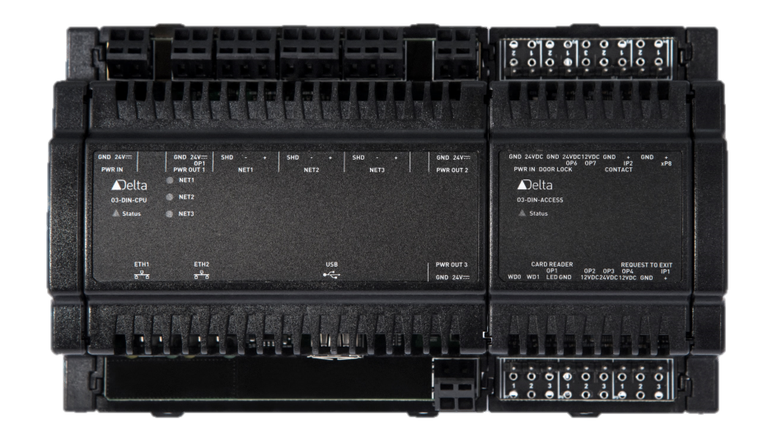






Delta Access Control Solution O₃ CPU
50,000
10,000
294/916
OSDP
anonymized access users (optional)
Local authentication and authorization
Multi-factor authentication
Confidential Property of Delta Controls Inc.

Slide 4
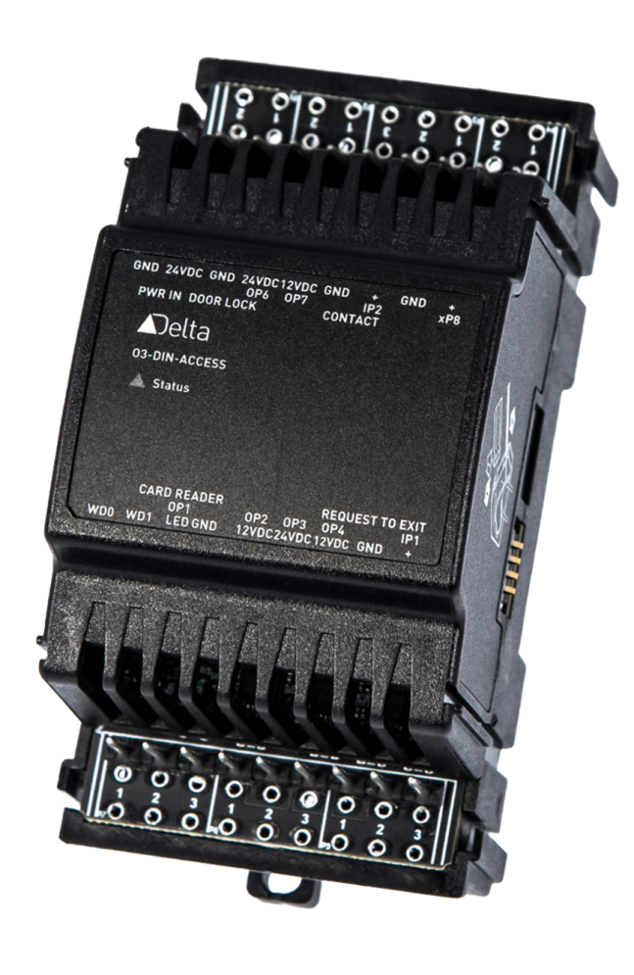








Delta Access Control Solution O₃ Access Module
single door
wiegand input
door contact, REX
door lock, cardreader LED
294
universal I/O
12V / 24V
Wiegand26, wiegand37, custom, GSA75

Slide 5
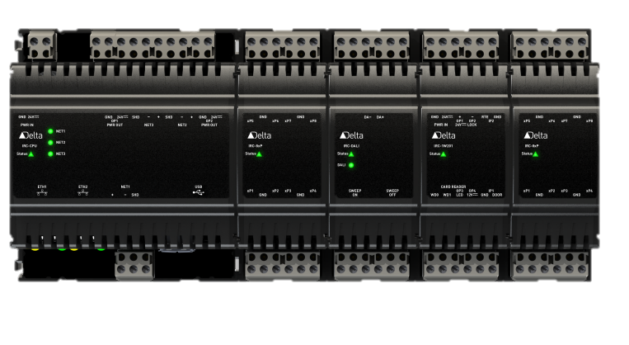
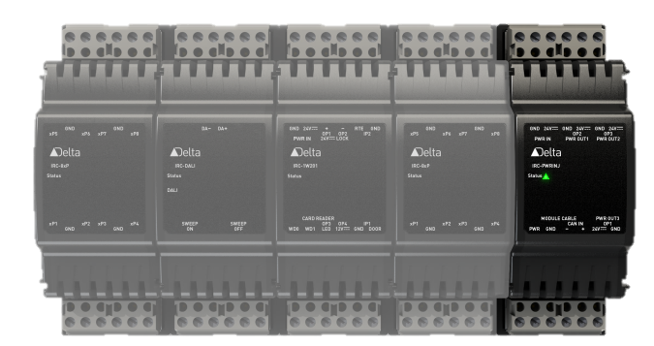
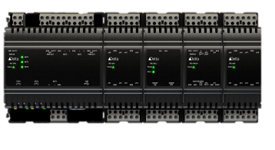
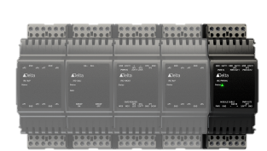
Delta Access Control Solution O₃ Modular Solution
Max 4 modules
Max 4 modules
CAN bus
The number of doors controlled by a single O3 can be extended to a max of 24 by connecting up to 5 Power Injectors
<= 70m

Slide 6
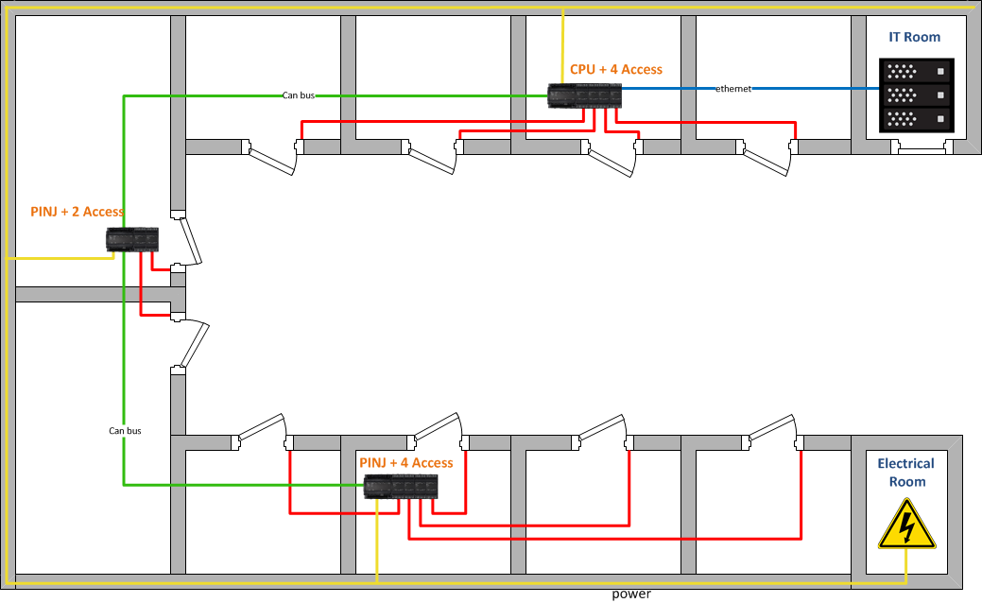
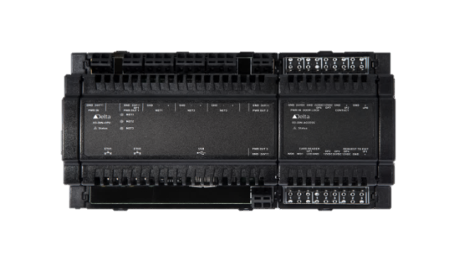
Delta Access Control Solution O₃ Modular Solution
distributed access control system with similar architecture to ASM & ADM

Slide 7
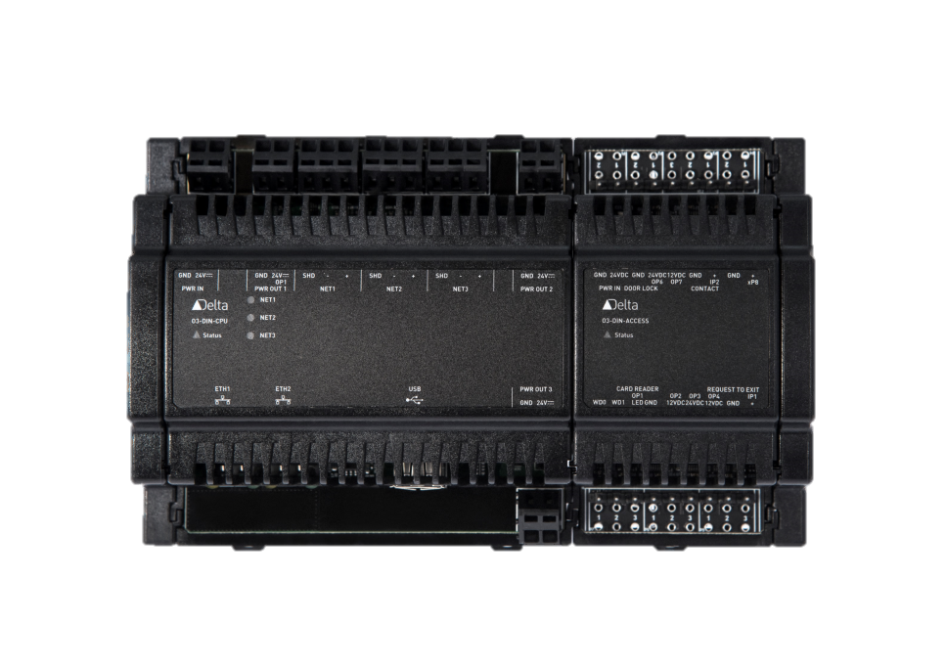
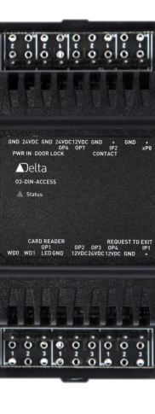




Delta Access Control Solution O₃ PoE Access (roadmap)
2 door (or 1 bidirectional)
802.3bt 60W (4P PoE)
OSDP & wiegand
PoE install typically requires ½ time and resources
12V / 24V
Battery backup at the switch
294

Slide 8
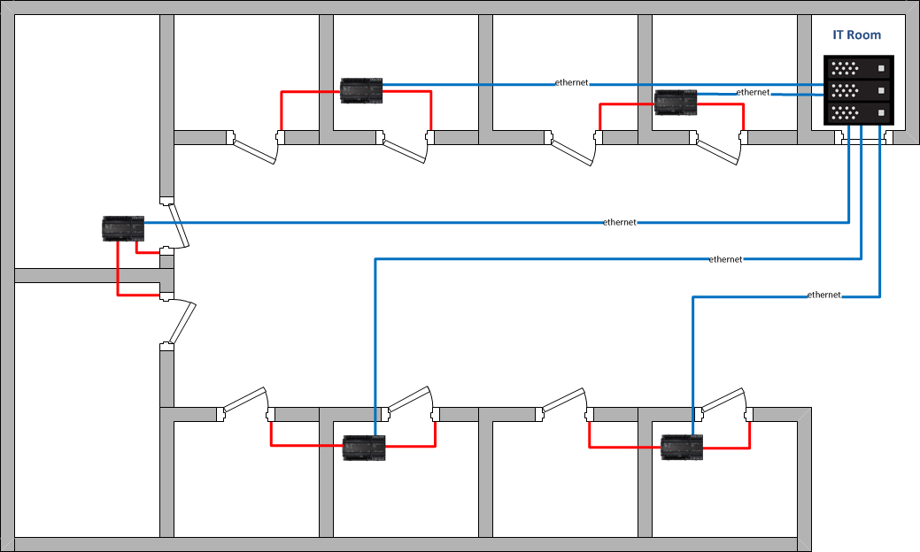
Delta Access Control Solution O₃ PoE Access Controller
  Simplified installation and wiring
  Saves on labor installation only CAT5/6 cable
  Battery backup at the server

Slide 9
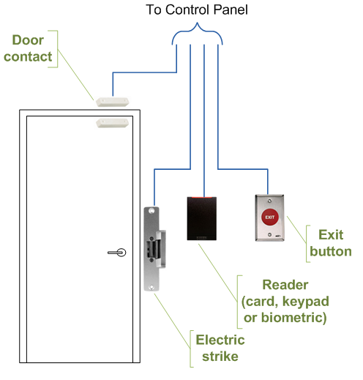
Delta Access Control Solution
Typical Single Direction Door
  1 - O3-DIN-ACCESS with 12/24 electric strike, card reader, door contact, and 12/24 request to exit device
Single Direction Door with holder
  1 - O3-DIN-ACCESS with 12/24 electric strike, card reader, door contact, and 12/24 request to exit device, and 12/24VDC door holder

Slide 10





Delta Access Control Solution
Synchronization engine (V3 & V4)
Master database
Fault-tolerant
Event log

Slide 11

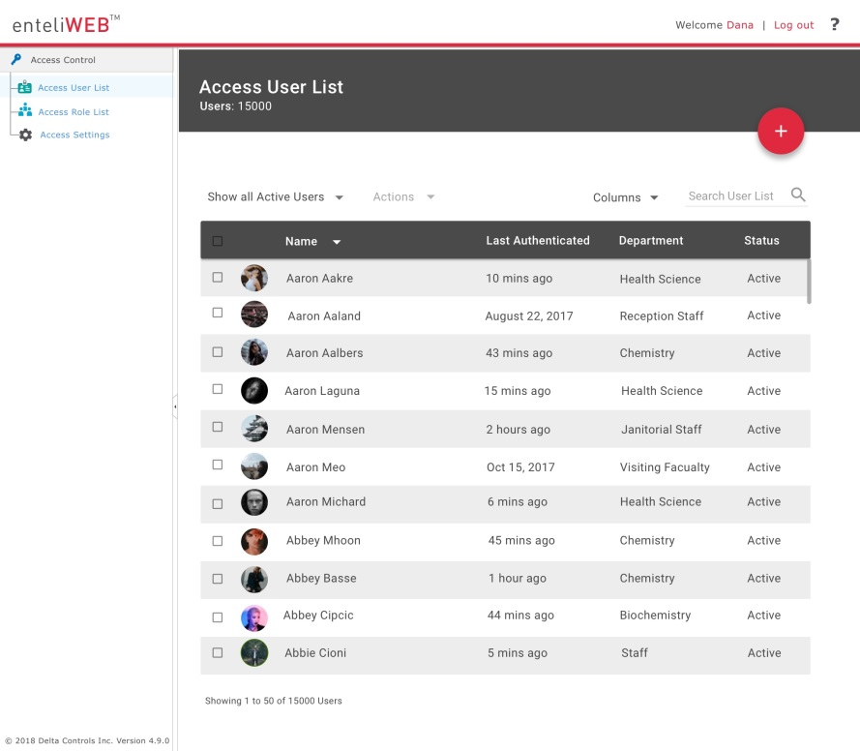




Access Control V4: Access Dashboard
Delta Access Control Solution eWEB Access Dashboard
A customizable intuitive dashboard for non-technical users

Slide 12
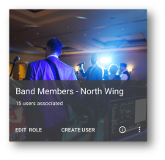






Delta Access Control Solution eWEB Access Dashboard
Role based permissions make enrolling a new user simple and intuitive
The permissions for each user are customizable

Slide 13
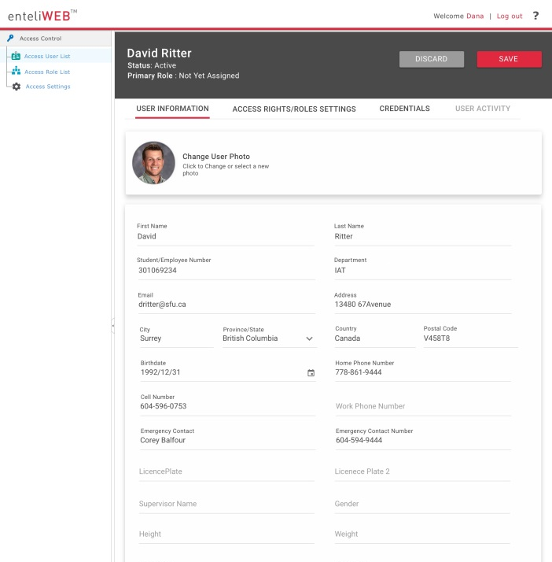
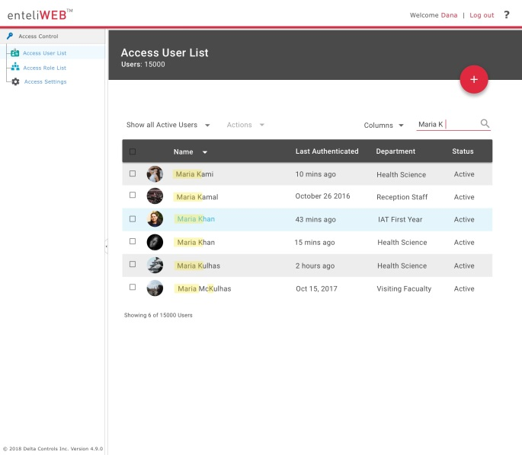
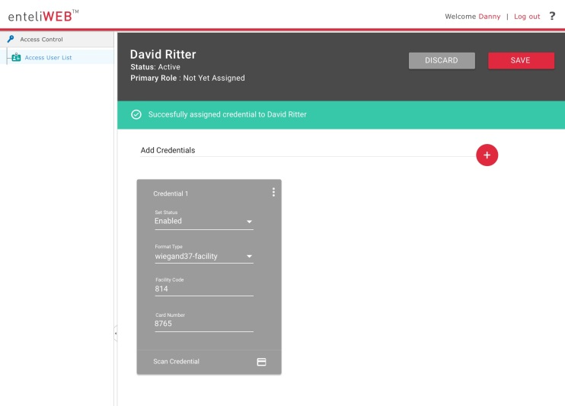
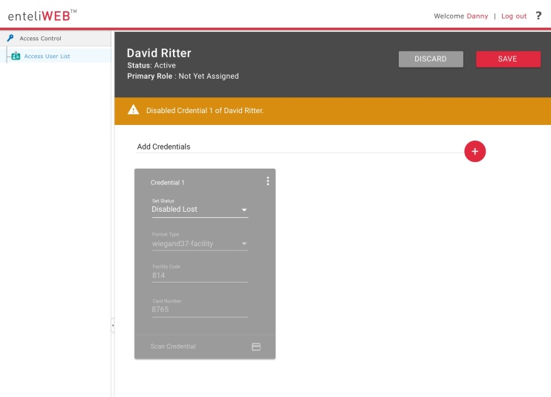
Delta Access Control Solution eWEB Access Dashboard
Powerful search capabilities
Intuitive visualization

Slide 14
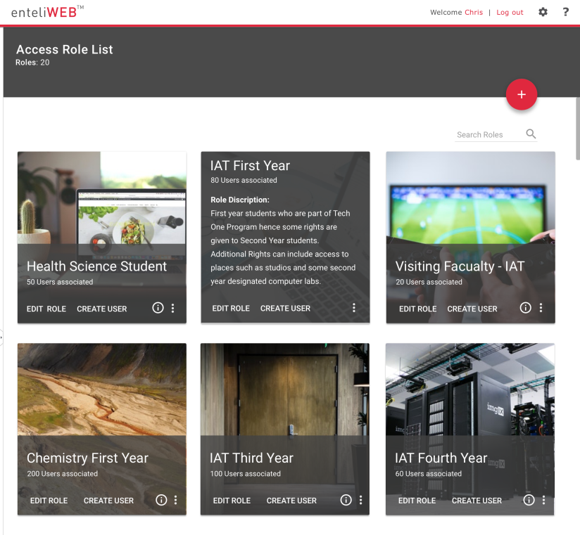
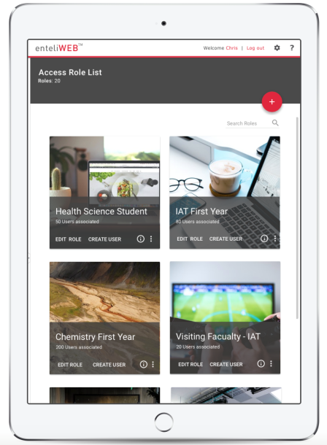
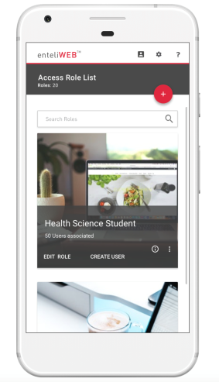
Delta Access Control Solution eWEB Access Dashboard
A responsive design means the dashboard can be used on different types of devices

Slide 15
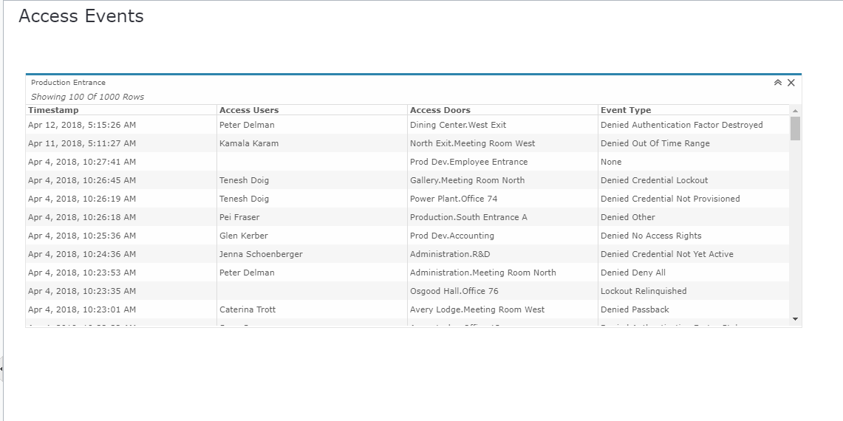
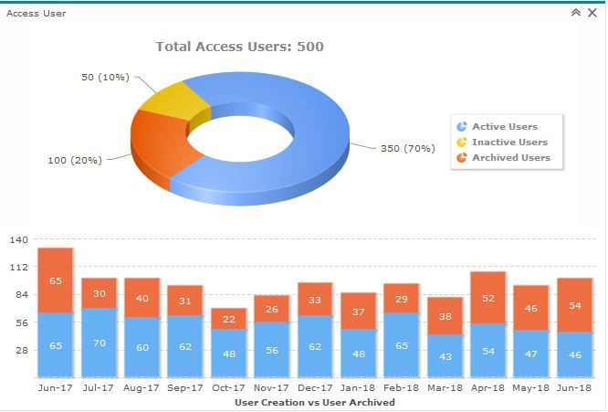
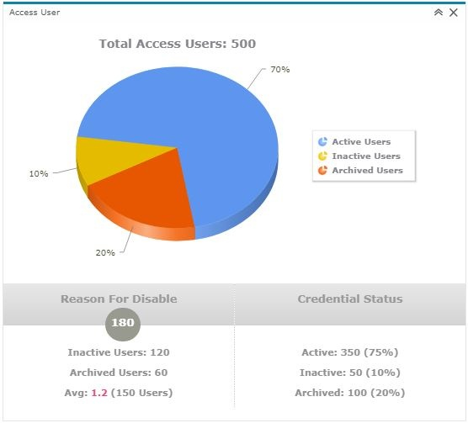
Delta Access Control Solution eWEB Access Widgets

Slide 16
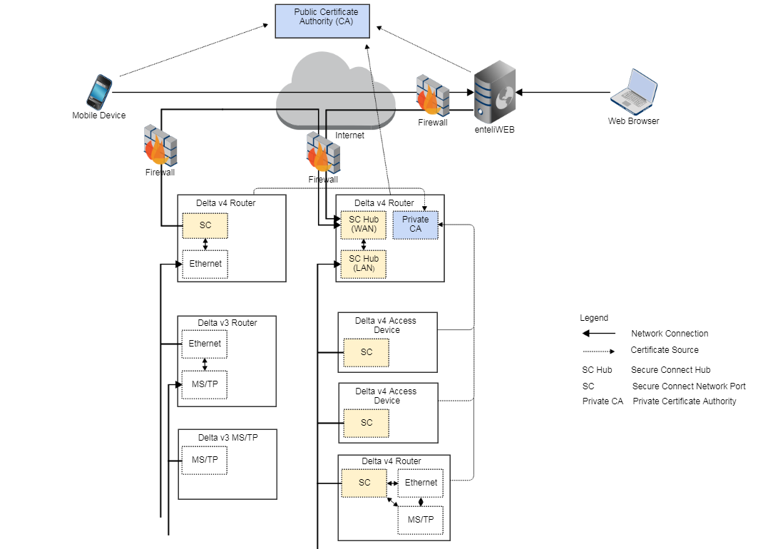



Delta Access Control Solution BACnet Secure Connect (BACnet/SC)
TLS encryption
Digital certificates
Public/private keys infrastructure

